Slide 1
Artificial Intelligence for All
Oğul Ünal
Nikita Kudriashov
Introduction to AI & Fields

Slide 2
Artificial intelligence is the implementation of computer recognition, reasoning, and action.
There are main sub-fields of AI such as:
1-Machine Learning
2-Neural Networks
3-Robotics
4-Expert Systems
5-Fuzzy Logic
6-Natural Language Processing
7-Computer Vision
8-Speech Recognition
9-Deep learning
10-Data science
11-Cyber security
12-Terminator

Slide 3
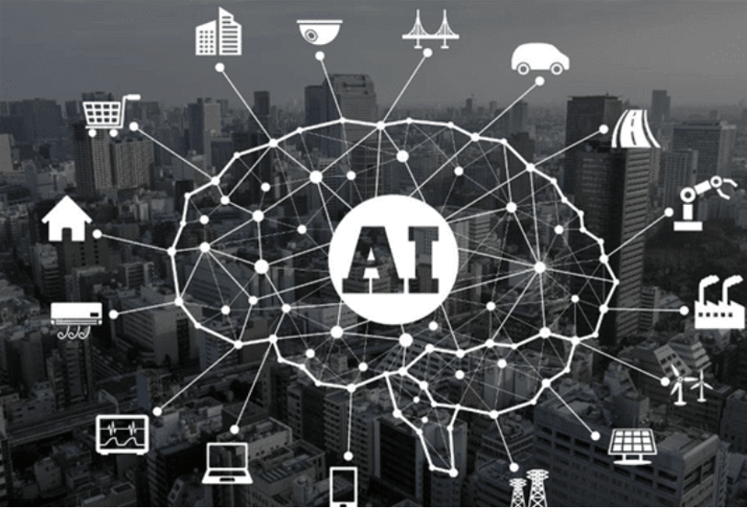

Slide 4
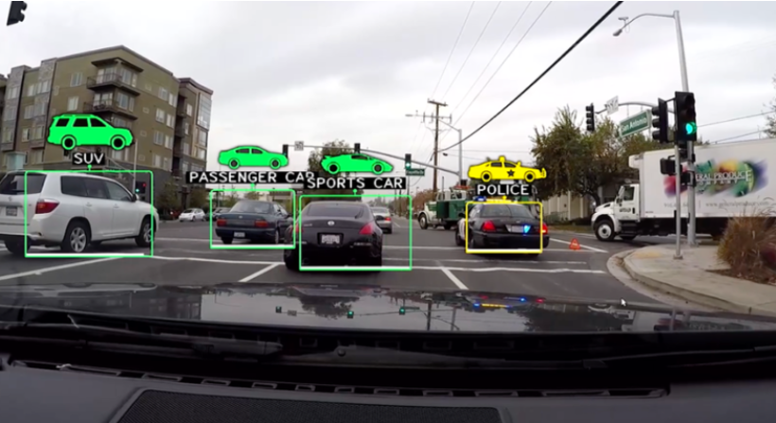
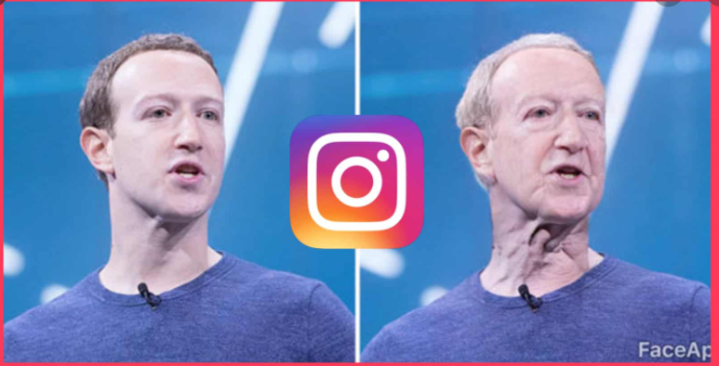

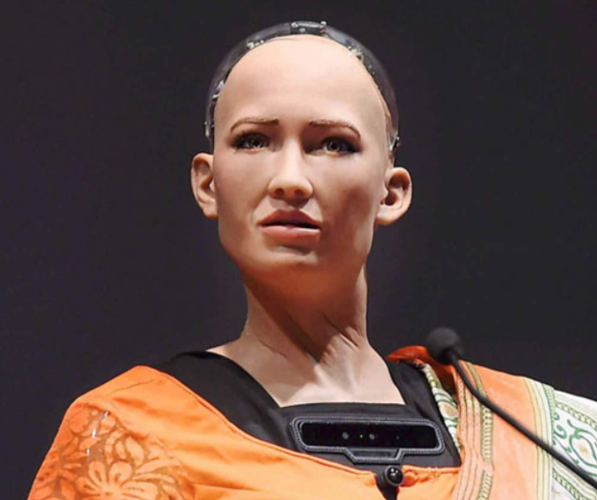

Slide 5
1- Machine Learning
This is a basic defintion of ML. We will cover the ML topic later in this course.
ML is the field that enables machines to translate, execute and investigate data for solving real-world problems.
ML algorithms are created by complex mathematical skills that are coded in order to make a complete system.

Slide 6
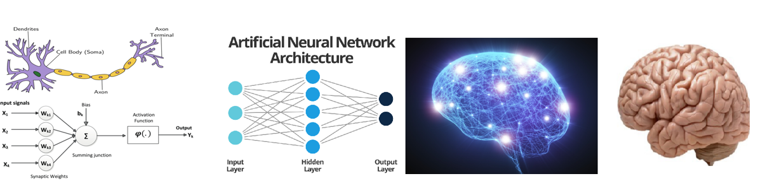
2-Neural Networks
NN’s are subfield of AI and they are widely being used in ML applications.
Neural networks are a computing technology inspired by the information processing technique of the human brain. The operation of the simple biological nervous system is imitated with NN. In other words, it is digital modeling of biological neuron cells and the synaptic connection between these cells with each other.

Slide 7
3-Robotics
Robotics is the study of robots. Robots are machines that can be used to do jobs. Some robots can do work by themselves. Other robots must always have a person telling them what to do.
Robotics is an interdisciplinary field of science and engineering incorporated with mechanical engineering, electrical engineering, computer science, and many others.
Robotics determines the designing, producing, operating, and usage of robots. It deals with computer systems for their control, intelligent outcomes, and information transformation.
Robots are deployed often for conducting tasks that might be laborious for humans to perform steadily.
Today's AI-powered robots, or at least those machines deemed as such, possess no natural general intelligence, but they are capable of solving problems and "thinking" in a limited capacity.

Slide 8
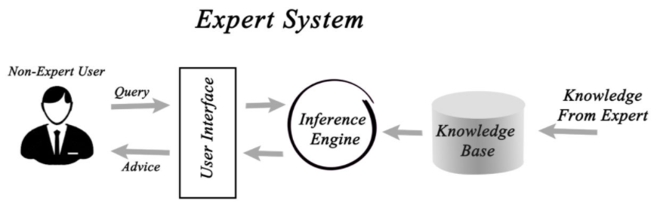
4-Expert Systems
Sub field of the AI technology, an expert system refers to a computer system that mimics the decision-making intelligence of a human expert.
Expert systems are built to deal with complex problems via reasoning through the bodies of proficiency, expressed especially in particular of “if-then” rules instead of traditional agenda to code.

Slide 9
Knowledge base: The knowledge base in an expert system represents facts and rules. It contains knowledge in specific domains along with rules in order to solve problems, and form procedures that are relevant to the domain.
Inference engine: The most basic function of the inference engine is to acquire relevant data from the knowledge base, interpret it, and to find a solution as per the user’s problem. Inference engines also have explanationatory and debugging abilities.
Knowledge acquisition and learning module: This component functions to allow the expert systems to acquire more data from various sources and store it in the knowledge base.
User interface: This component is essential for a non-expert user to interact with the expert system and find solutions.
Explanation module: As the name suggests, this module helps in providing the user with an explanation of the achieved conclusion.

Slide 10
Several Common Examples of Expert Systems
MYCIN: This was one of the earliest expert systems that was based on backward chaining. It has the ability to identify various bacteria that cause severe infections. It is also capable of recommending drugs based on a person’s weight.
DENDRAL: This was an AI based expert system used essentially for chemical analysis. It uses a substance’s spectrographic data in order to predict its molecular structure.
R1/XCON: This ES had the ability to select specific software to generate a computer system as per user preference.
PXDES: This system could easily determine the type and the degree of lung cancer in patients based on limited data.
CaDet: This is a clinical support system that identifies cancer in early stages.
DXplain: This is also a clinical support system that is capable of suggesting a variety of diseases based on just the findings of the doctor.

Slide 11
In general you may use Expert systems in:
Information management
Hospitals and medical facilities
Help desks management
Employee performance evaluation
Loan analysis
Virus detection
Useful for repair and maintenance projects
Warehouse optimization
Planning and scheduling
The configuration of manufactured objects
Financial decision making Knowledge publishing
Process monitoring and control
Supervise the operation of the plant and controller
Stock market trading
Airline scheduling & cargo schedules

Slide 12
AI is a science which deals with making the machine intelligent. It utilizes image processing, cognitive science, neural systems, machine learning etc. AI enables machines to behave in a similar manner as human behaves in varying situations.
Expert System is an application using AI to build a knowledge base and use that knowledge base to solve such problems where human experts are needed to solve the problem. An expert system can advise users on the problem and can provide an explanation of the solution which is required for the users.
Artificial Intelligence targets to make machines intelligent.
Expert System is an application using Artificial Intelligence.

Slide 13
5-Fuzzy Logic
Fuzzy logic is a technique for representing and manipulating uncertain information.
The term fuzzy refers to things which are not clear or are vague.
In boolean system truth value, 1.0 represents absolute truth value and 0.0 represents absolute false value. But in the fuzzy system, there is no logic for absolute truth and absolute false value. But in fuzzy logic, there is intermediate value to present which is partially true and partially false.

Slide 14
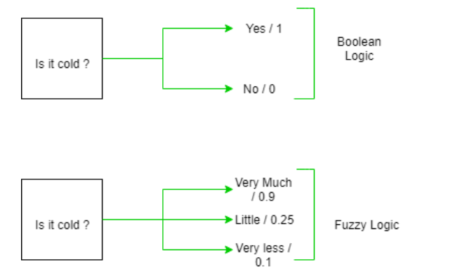
It can control machines and consumer products.
It may not give accurate reasoning, but acceptable reasoning.
Fuzzy logic helps to deal with the uncertainty in engineering.

Slide 15
Aerospace
Altitude control of spacecraft
Satellite altitude control
Flow and mixture regulation in aircraft deicing vehicles
Automotive
Trainable fuzzy systems for idle speed control
Shift scheduling method for automatic transmission
Intelligent highway systems
Traffic control
Improving efficiency of automatic transmissions
Defense
Underwater target recognition
Automatic target recognition of thermal infrared images
Naval decision support aids
Electronics
Control of automatic exposure in video cameras
Humidity in a clean room
Air conditioning systems
Washing machine timing
Microwave ovens
Vacuum cleaners
Industry
Cement kiln controls heat exchanger control
Activated sludge wastewater treatment process control
Water purification plant control
Quantitative pattern analysis for industrial quality assurance
Control of constraint satisfaction problems in structural design
Control of water purification plants

Slide 16
6-Natural Language Processing
Natural language processing depicts the developing methods that assist in communicating with machines using human languages.
NLP is the processing of the human language by computer programs, examples include; spam detection by looking at the subject of a line or text of an email and checking if it is junk.
NLP tasks are text translation, sentiment analysis, and speech recognition. NLP is used by Twitter to percolate terroristic language from their tweets, by amazon to interpret user reviews and enhance user experience.
Examples: Auto-correct, Chatbots, Google-Translate, spam detection

Slide 17
7-Computer Vision
Computer Vision, is defined as a field of study that seeks to develop techniques to help computers “see” and understand the content of digital images such as photographs and videos.
Smartphones have cameras, and taking a photo or video and sharing it has never been easier, resulting in the incredible growth of modern social networks like Instagram.
YouTube might be the second largest search engine and hundreds of hours of video are uploaded every minute and billions of videos are watched every day.
The internet is comprised of text and images. It is relatively straightforward to index and search text, but in order to index and search images, algorithms need to know what the images contain.

Slide 18
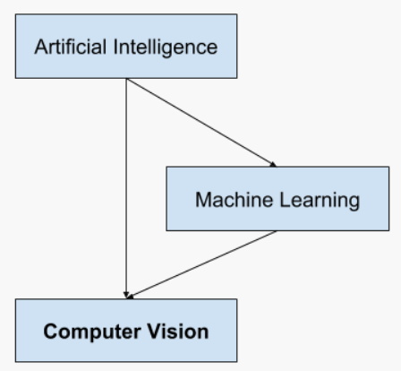
To a computer, an image is an array of pixels, numerical values that represent shades of red, green, and blue. One of the challenges computer scientists have grappled with since the 1950s has been to create machines that can make sense of photos and videos like humans do. The field of computer vision has become one of the hottest areas of research in computer science and artificial intelligence.

Slide 19
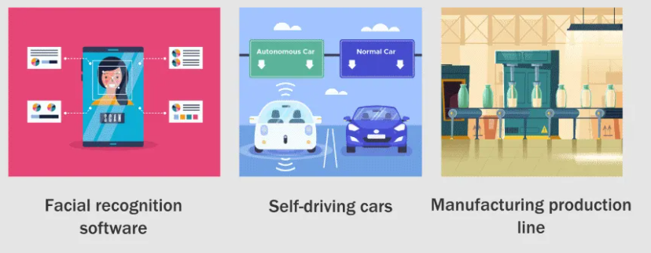
Applications of Computer Vision

Slide 20
8-Speech Recognition
Speech recognition, the ability of devices to respond to spoken commands. Speech recognition enables hands-free control of various devices and equipment (a particular boon to many disabled persons), provides input to automatic translation, and creates print-ready dictation. Among the earliest applications for speech recognition were automated telephone systems and medical dictation software. It is frequently used for dictation, for querying databases, and for giving commands to computer-based systems, especially in professions that rely on specialized vocabularies. It also enables personal assistants in vehicles and smartphones, such as Amazon’s Alexa.

Slide 21
9-Deep learning
Deep learning is the field of study that includes artificial neural networks(NN’S) and similar machine learning algorithms with one or more hidden layers. In other words, at least one artificial neural network is used and the computer obtains new data from the available data with many algorithms.
Self Driving Cars.
News Aggregation and Fraud News Detection.
Natural Language Processing.
Virtual Assistants.
Entertainment.
Visual Recognition.
Fraud Detection.
Healthcare.

Slide 22
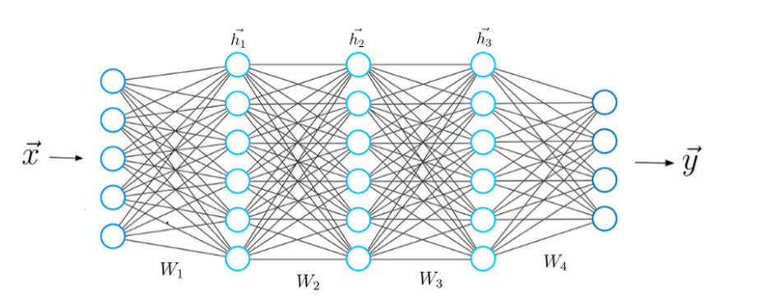
A Neural Network

Slide 23
Deep learning has evolved hand-in-hand with the digital era, which has brought about an explosion of data in all forms and from every region of the world. This data, known simply as big data, is drawn from sources like social media, internet search engines, e-commerce platforms, and online cinemas, among others. This enormous amount of data is readily accessible and can be shared through cloud computing.

Slide 24
Examples
Virtual assistants: e.g Alexa siri, or Cortana
Translations
Chatbots and service bots
Image colorization
Facial recognition e.g. Facebook
Shopping and Entertainment e.g. Amazon, Netflix

Slide 25
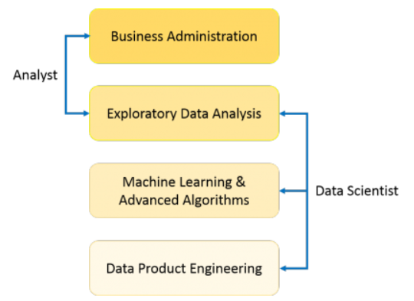
10-Data science
Data science is a multidisciplinary field that uses scientific methods, processes, algorithms, and systems to extract information and insight from structured and unstructured data. Data science is related to data mining and big data

Slide 26
A Data Analyst usually explains what is going on by processing history of the data.
A Data Scientist will look at the data from many angles, sometimes angles not known earlier

Slide 27
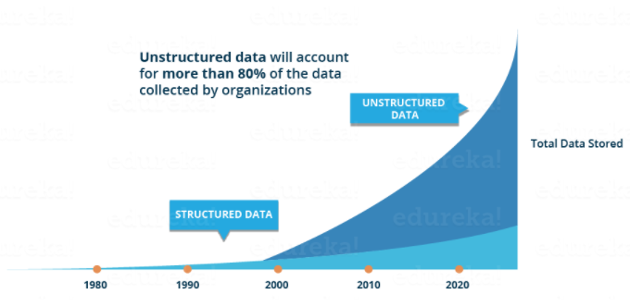
Why do we need it?

Slide 28
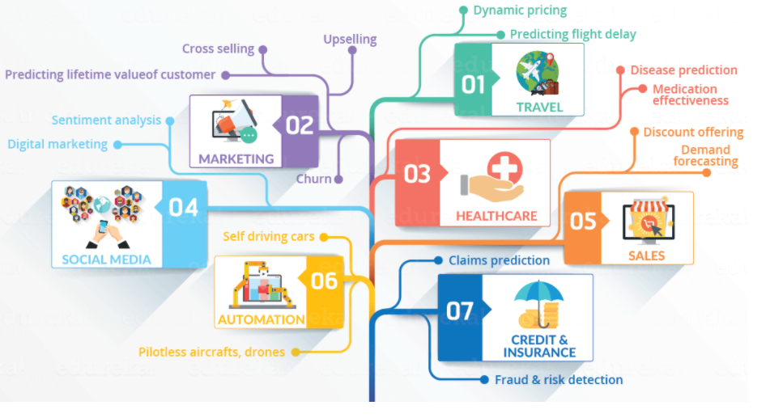

Slide 29
BI vs Data Science
Business Intelligence (BI) basically analyzes the previous data to find insights to describe business trends. Here BI enables you to take data from external and internal sources, prepare it, run queries on it and create dashboards to answer questions like quarterly revenue analysis or business problems. BI can evaluate the impact of certain events in the near future.
Data Science is a more forward-looking approach, an exploratory way with the focus on analyzing the past or current data and predicting the future outcomes with the aim of making informed decisions. It answers the open-ended questions as to “what” and “how” events occur.

Slide 30
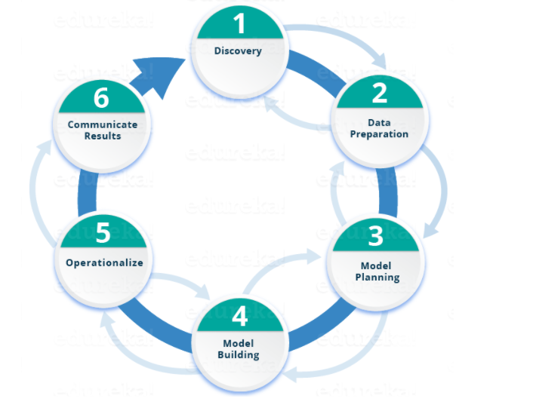

Slide 31
11-Cyber security
Cyber security is the practice of defending computers, servers, mobile devices, electronic systems, networks, and data from malicious attacks.
AI allows cybersecurity teams to form powerful human-machine partnerships that push the boundaries of our knowledge, enrich our lives, and drive cybersecurity in a way that seems greater than the sum of its parts.
AI-based Antivirus Software – Anomaly Detection in Computers and systems
User Behavior Modeling
Email monitoring (NLP)
The use of AI in cybersecurity can be named still as new at the moment. Companies make sure that their systems are prepared with the inputs of cybersecurity specialists who improve the software at identifying cyber attacks with more precision.

Slide 32
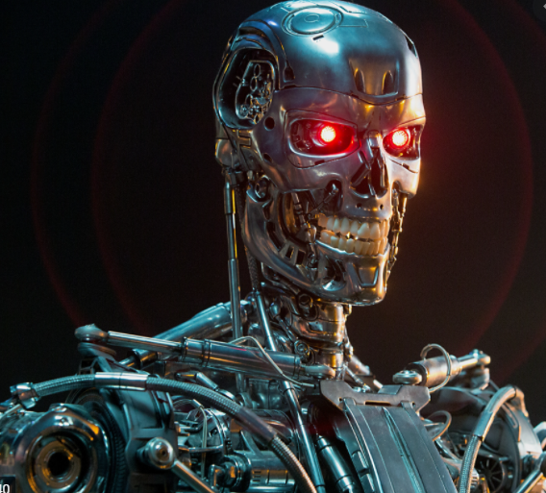
12-Terminator
Does this machine know that he is smiling?
A concept of Strong AI(full awareness)
It is not yet possible to give them full awareness, perhaps no need.

Slide 33
This chapter is a philosophical discussion about AI. It might be awkward but philosophy and AI has strong relations here is why:
Intuitive concepts are empty. Conceptless intuition is blind – Immanuel Kant.
Can a machine move intelligently? Any person who can solve the problem by thinking it will solve the problem? Are human intelligence and machine intelligence the same? Is the human brain actually a computer?
While we can learn and recognize things so fast, computers do it slowly. But we may forget they don’t.
What about emotions, Love, jealousy and most importantly the consciousness.

Slide 34
If it is accepted that the basic idea of artificial intelligence is that human beings construct objects that have the ability to act and act on their own by imitating the creatures in nature, that is, automatons, it is seen that the first applications of this idea go back to the 4th century BC.
Deus ex Machina (Mechanical God) brought to the stage by means of a match to change the course of the play in an unexpected way, encountered in ancient Greek theater, for example in the plays of Sophocles and Oripides.
Machines have the ability to think - that's a very human trait. ‘After all, thanks to our ability to think, we were able to overcome our physical inadequacy and gain an advantage over other living things. If we lose this important feature that proves our superiority to machines one day, will we have to submit to them?’

Slide 35
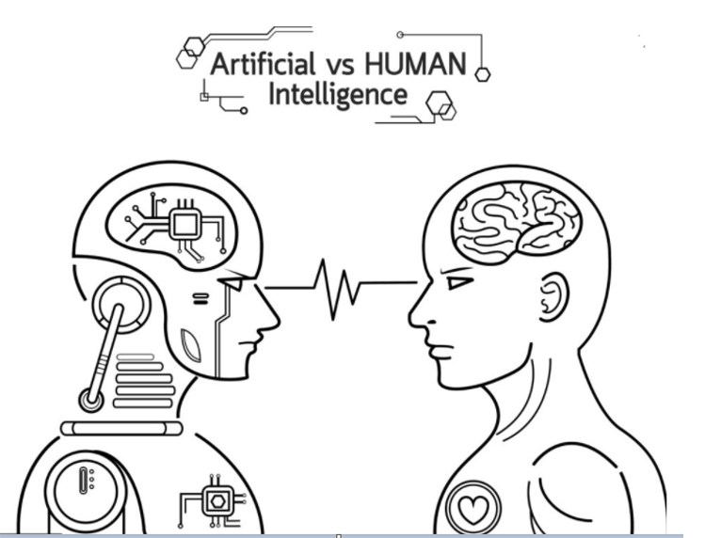

Slide 36
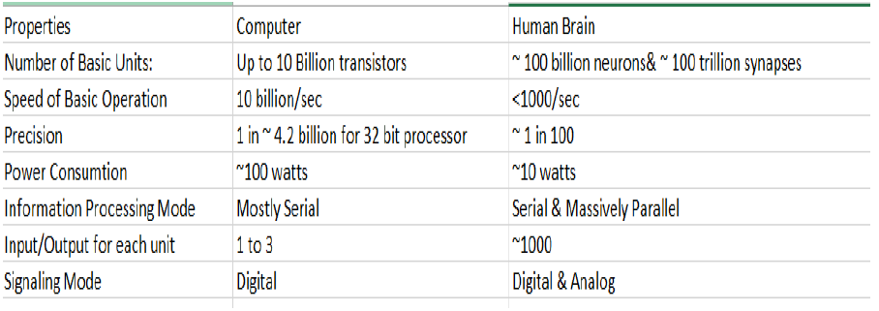
Artificial intelligence and machine learning won’t make much progress on modeling human cognition until this is fully acknowledged.

